Slide 1
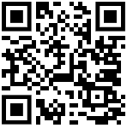
HIV & HEPATITIS Awareness
For Tattoo & Piercing Artists
Presented by [names]
Slides developed by @hivandhep.awareness
Website resources at nat.org.uk/bbv-tattooing-piercing
Artwork by @lauraemilytattoo
Notes:
This slide set is designed to be used by BBV advocacy organisations to facilitate delivery of BBV training for tattoo and piercing artists. Prior to use please also review the accompanying Strategy Kit available at: nat.org.uk/bbv-tattooing-piercing
Each organisation is invited to personalise these slides by replacing highlighted blanks with your own information. In the notes sections below each slide, text in italics is commentary, and text in plain text can be used as a script during training events.
Materials list for trainers when providing in-person events:
Post its (for start and end) and pens
Name tags (optional)
Markers
Kettle/tea/cups/milk
Laptop/projector/screen
Slides
Pens/paper (for those who may want to take notes)
Contact and information resources relating to your organisation and other local BBV support information

Slide 2
Today’s session
BBV transmission and prevention
Safety and precautions at work
Equality law
Privacy and consent forms
Little changes that make your workplace more safe, inclusive and massively build client TRUST
Notes:
Review the goals for today’s session using this slide

Slide 3
About us
Everyone needs to feel safe to share, knowing it won’t be gossiped about
Judgement-free zones support inclusion (there are no stupid questions)
Notes:
Introduction: trainers to introduce themselves and their organisation
Why talk about this?
There is a lot of old information and wrong information still in circulation about blood borne viruses. We know that in the UK, what artists have learned about these issues are passed on to them by their mentors, and that may also have come with some heavily judgemental attitudes about the people who are living with these illnesses.
The National AIDS Trust and other charities report that a major place where people living with BBVs report that they have experienced illegal discrimination is in tattooing, piercing and beauty businesses. Often businesses are not aware they are breaking the law if they treat a client differently or turn them away because of a disability.
The team developing this training have met with tattoo artists and piercers who would love to learn reliable, up to date information to make their practice safe and inclusive. Those discussions have helped build this training.
No Judgement
There are no stupid questions, and everyone in this session will be heard and spoken to with respect, as well as in confidence. What is shared here, stays here. Being considerate means we consider how our thoughts and our actions can impact others, and this is important for creating a good space to learn.

Slide 4
Your thoughts
Write down one:
thought or feeling
question
concern
experience
you might have about HIV or Hepatitis or how they are passed on
Notes:
Depending on how the session is delivered, this may be undertaken using pens/post it notes or if online using the chat function.
Collect the comments and group them a bit, and then individual facilitators will either ‘answer’ or ‘park’ some of the issues (park those we know we are going to cover in a moment anyhow).
This segment is likely to take at least 10 mins.

Slide 5
Hepatitis B Virus (HBV)
Affects the liver, usually causing acute (short-term with recovery) but sometimes leading to chronic (long-term) infections.
There are several safe effective treatments that reduce potential damage to the liver and the risk of onward transmission.
Hepatitis B transmission happens through vaginal/anal intercourse, blood-to-blood contact via needle-sharing or needlestick injury, or transmission from mother to child
Notes:
We will explain the differences between the viruses and their treatments using the text on the next few slides.
Most of the disease burden (>95%) in England is amongst migrants who have acquired infection overseas in endemic countries prior to arrival in the UK (3). Other communities at higher risk include people who inject drugs (PWID), gay, bisexual and men who have sex with men (GBMSM), sex workers and people detained in prisons or immigration detention centres.
Review slide content

Slide 6
Hepatitis B Vaccination
Vaccinations are recommended for people in occupations with a high risk of exposure
Immediately after a needlestick injury a Hep B vaccination can massively reduce the risk of infection (*important if you have never been vaccinated or are not up to date with boosters)
Hep B vaccinations work incredibly well to prevent infection ahead of exposure
Notes:
Because of advocacy from HIVandHep.awareness, the UK Health Security Agency changed their guidance on Hepatitis B vaccination in 2024 so it now says: in some occupations, such as morticians, embalmers and tattoo artists, where the job routinely involves using needles to puncture or pierce the skin, there is a risk of hepatitis B exposure and so immunisation should be offered.
However, this recommendation doesn’t clarify who should pay for the vaccination, so these might possibly be paid for by your studio, but not always.
Review text on the slide and point out there will be more discussion about following up after a needlestick injury later in the session

Slide 7
Hepatitis C Virus (HCV)
Also affects the liver, causing an acute (short term with recovery) or a chronic (long term) infection.
Almost 90% of hepatitis C cases in the UK happen in people who inject drugs (including steroids) or have injected them in the past. Sexual transmission is not that common, but the risk increases among some men who have sex with men, especially those with other infections.
A full course of treatment will now cure Hepatitis C infection
Notes:
Review material on the slide. You can also note:
It's estimated around half of the people in the UK who inject drugs have been infected with the virus, and almost 90% of Hep C cases in the UK occur in people who inject drugs (including steroids). There is some risk of being infected through needlestick injury if a source is undiagnosed or untreated. In a study that tracked healthcare workers with needlestick injuries over 20 years, there was around one or two new HCV infections per year from nearly 9000 injuries, but none since 2015 (and this is likely because of the amazing treatment that now cures HCV). Sexual transmission is not that common, but the risk increases among some men who have sex with men, especially those with other infections.

Slide 8
New treatment for Hep C
Now, one pill a day cures 98% of people living with diagnosed Hep C within 12 weeks.
Earlier treatments were less effective and had more side effects.
Anyone in the UK can order a free Hep C test online: https://hepctest.nhs.uk/
Notes:
Review text on slide and draw attention to Hep C screening information
There is currently a strong push in the UK and other countries to try to eliminate Hepatitis C through increased testing and treatment.

Slide 9
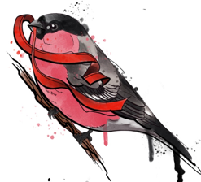
Human Immunodeficiency Virus (HIV)
A virus which affects the body’s immune system and, if not treated, makes it susceptible to severe infections and other serious illnesses
HIV transmission happens through vaginal/anal intercourse, blood-to-blood contact via needle-sharing or needlestick injury, or transmission from mother to child
Although there is no cure for HIV currently, there is treatment available which can reduce the level of virus in the blood to undetectable
The overwhelming majority of people with diagnosed HIV in the UK are on treatment and have undetectable levels of the virus in their blood (98%). This means they cannot pass it on to others, and they will also remain in good health.
Art by Scarlet @ Blue Punk
Notes:
Review information on the slide, and then also note:
People who don’t know they have HIV are most likely to be infectious, and they don’t know it themselves, so they are not in a position to tell you about that risk one way or another.
That same UK study we mentioned earlier that tracked nearly 9000 workplace needlestick injuries in the UK for twenty years since 1999 found that there were NO cases of HIV being passed on in any of them. from https://bhiva.org/wp-content/uploads/2024/10/PEP-guidelines.pdf page 24
So also just as a reminder, you cannot get ANY BBV by:
Sharing a toilet seat
Kissing
Touching
Where bodily fluids touch unbroken skin

Slide 10
Notes:
Point out that free testing may vary across the UK, but this link offers a good starting point to find out about accessing a free HIV screening kit.
Follow this up by preparing people for the next few slides by saying something like:
The next couple of slides have some graphs – they help to answer questions that people are always asking about – in terms of how infectious these different viruses are. Some people can be put off by information shared in graphs, others love it. We hope they help to tell a clear story about the risks you all want to know a bit more about.

Slide 11
What is the risk of infection following a puncture injury where the source is known to have an acute (actively infectious) BBV?
Source for next 3 slides: Guidance on management of potential exposure to blood-borne viruses in emergency workers: For occupational health service providers and frontline staff Public Health England, 2019: p9-11
Notes:
What a lot of artists want to know about, is how risky is it if an incident happens were there is exposure to body fluids.
Even where there is confirmed virus present, the likelihood of BBV transmission risk during bite/splash incidents is vanishingly small to nil.
For puncture incidents the risk is highest for Hepatitis B (estimated up to 30% risk if there is contamination of blood or bodily fluids containing blood infected with HBV and no vaccination or treatment provided). With Hep B vaccination and/or immediate treatment of the person exposed this risk is considerably reduced.
The risk of transmission during puncture incidents resulting in Hepatitis C transmission – including in cases where a source is known to be infected and untreated - are estimated to be between 1 to 3 in 100.
For HIV the estimated risk of transmission during a puncture incident drops to an estimated 3 in 1000. HIV therefore should not be something that you or your professional colleagues see as the BBV carrying the greatest exposure risk. UK data from 1999 to 2018 have found no new cases of HIV after 8765 reported significant occupational exposures among healthcare workers. (from https://bhiva.org/wp-content/uploads/2024/10/PEP-guidelines.pdf page

Slide 12
How many people in England are living with these BBVs?
Notes:
Note: Hep B prevalence is taken from this report:
https://assets.publishing.service.gov.uk/media/63dba059d3bf7f0704f31d37/Hepatitis_B_in_England_2023.pdf
Hep C prevalence is taken from this report: https://www.gov.uk/government/publications/hepatitis-c-in-the-uk/hepatitis-c-in-england-2023#reducing-the-incidence-of-hcv-infection
HIV prevalence is taken from this page: https://nat.org.uk/about-hiv/hiv-statistics/ and https://www.gov.uk/government/statistics/hiv-annual-data-tables

Slide 13
Where BBV history is either known to be acute or unknown
What is the comparative risk of infection following a puncture injury where BBV history is known to be acute or unknown?
Notes:
This chart shows the calculated chances of infection after a needlestick injury in the UK where it is unknown if a client has a BBV compared to where it is known that they have acute/infectious viral levels (yellow – same as the initial graph)
HIV risk in needlestick injuries where BBV history is unknown – too small to calculate – and there are no known UK cases since 1999 when it was first looked at.
Hep C risk in needlestick injuries – where BBV history is unknown - 4 per 100,000 needlestick incidents
Hep B risk in needlestick injuries – where BBV history of source is unknown - 135 per 100,000 needlestick incidents
workings for checking these figures based on background population prevalence:
HIV population prevalence in England 0.0017 (of 56.5 m) x 0.3% risk
Hep C pop prevalence 0.0014 (of 56.5 m) x 3% risk
Hep B pop prevalence 0.0045 (of 56.5m) x 30% risk

Slide 14
Managing a needlestick injury
Hep B vaccine or top up may be recommended
Test at 3 and 6 months if desired – given very low risk
If source is known to have acute BBV, clinic will assess and manage accordingly
Call for medical advice (such as 111 in the UK)
The website has posters for artists about needlestick procedures.
Notes:
So the chances of an infection happening following exposure are vanishingly low for HIV. For this reason, even if a needlestick injury happens at work, current clinical advice is not to give emergency treatment unless there is a strong reason for concern about known infectiousness in the source individual. This is taken from the British HIV Association Guidelines https://bhiva.org/wp-content/uploads/2024/10/PEP-guidelines.pdf page 31
The risk of infection is a bit higher for Hep C and even greater for Hepatitis B, which is why keeping your own testing and your vaccinations up to date and calling 111 after an exposure to see if you need an emergency Hep B jab is important.
Takeaway messages :
Always report a needlestick injury – don’t just carry on. Let your client know it has happened too.
If your needlestick injury happens when working with a client you know is living with a BBV, then this is important information to share when you report.
But your odds of acquiring HIV are so small it’s hard to measure, odds of Hepatitis C are slightly more, so it’s worth being tested when you can, but odds of Hepatitis B exposure and infection are higher (yet still not massive), so being vaccinated ahead of time is your best protection.

Slide 15
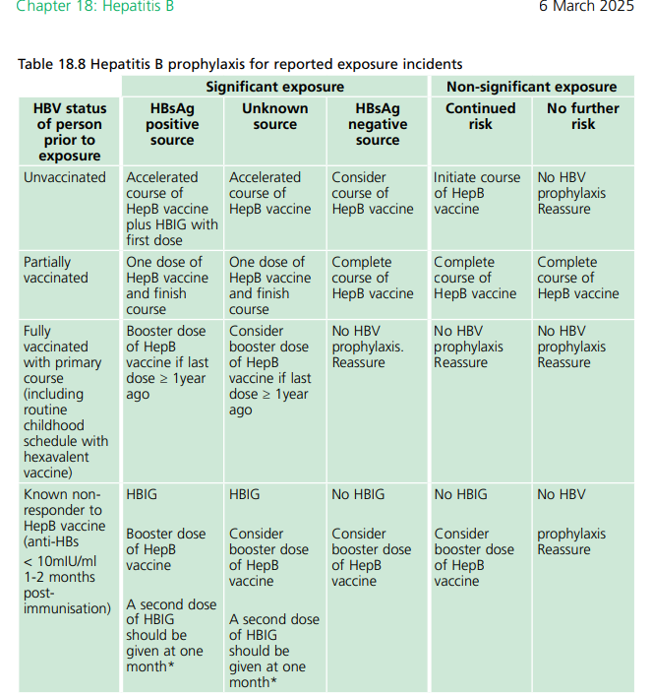
UK Clinical guidance for Hep B management after a needlestick incident
https://assets.publishing.service.gov.uk/media/67cf3f5f75d299c71177bd34/Hepatitis-B-green_book-chapter-18-06-03-2025.pdf
Notes:
If you need to report a needlestick, it may be useful for you to be aware of current clinical advice on Hep B vaccination after a needlestick injury in a high-risk occupation such as yours.
This table is on page 22 in UKHSA Green Book.
If an incident happens search online for Green Book Hepatitis B and refer to it when reporting your incident to 111 or A&E.
https://assets.publishing.service.gov.uk/media/67cf3f5f75d299c71177bd34/Hepatitis-B-green_book-chapter-18-06-03-2025.pdf

Slide 16
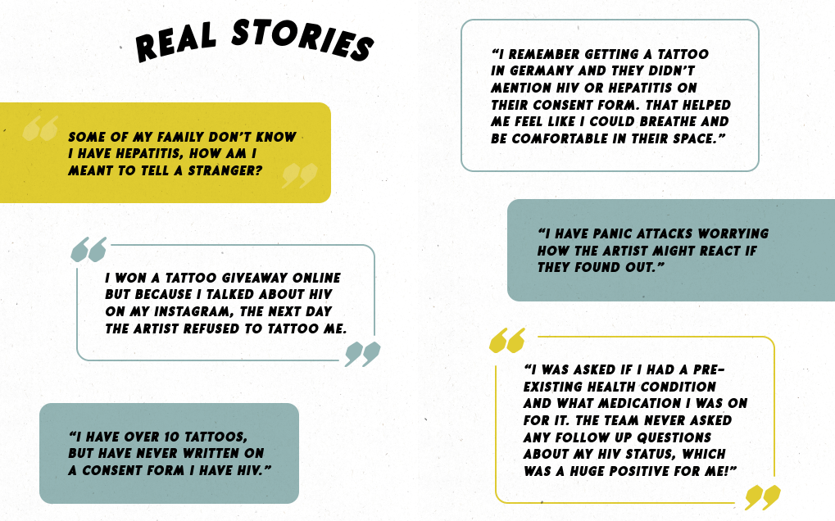
Notes:
These are just a few thoughts from real people living with HIV and Hepatitis when it comes to their experiences of tattooing and piercing.
It’s important to open up these conversations, and let you hear some of the things that some of your clients may struggle to share with you until they know they can trust you. To talk about why that may be the case. And to talk about the ways that we can help you to help everyone feel an be safer when it comes to blood borne viruses in your workplaces.

Slide 17
Health questions on consent forms
WHY is your form asking about BBVs?
HOW would knowing a client is living with a BBV change your safety practices?
WHERE does health information you ask about get stored? WHO has access? WHEN is it destroyed? HOW will your client be informed about how you manage their information?
HOW might information on the form influence your response to a needlestick injury?
Website has inclusive consent forms you can adapt!!
Notes:
Your consent forms will all include some health questions. What’s asked in the places where you work, and how is it used?
In particular, how is information about blood borne viruses asked about and what happens when someone says they are living with HIV or Hepatitis?
Talk together about how this information tends to get used where you work.
Use the questions on this slide to help guide your discussion.
It will be really helpful to gain a sense of whether you do anything differently depending on someone disclosing a blood borne virus, and if so, what and why?
[discuss for 5 minutes, then open up for wider group discussion]

Slide 18
Universal precautions…
Help you and your clients to have a better, safer experience and build TRUST
Check out Kezz’s Tattoo Hygiene Course
@tattoosmarter
Notes:
Building inclusion into your studio practice builds trust.
When your clients living with BBVs feel safe in your space, you can open up discussions with them in supportive ways that may not otherwise be possible.
But remember, you don’t have a right to be told about anyone’s health information, which is why universal precautions are so vital for you and for your clients’ safety and protection.
Open a discussion in the room about the types of universal precautions these professionals use / should use with all clients, regardless of what is written on consent forms.

Slide 19
UK Equality Law
Under the UK Equality Act 2010 it is illegal to refuse or unreasonably change a service for someone living with HIV.
Hepatitis is not named in the Act, but it can be considered a disability protected by law for those whose daily lives are affected (in certain circumstances).
*Outside the UK? Check your disability laws
Notes:
Review slide, and mention:
National AIDS Trust connects people living with HIV who experience discrimination to legal advice through their Discrimination Advice service. The same settings for discrimination recur again and again.
Artists can avoid discrimination by using universal precautions (such as clean equipment, fresh gloves, aprons and arm-sleeves) with every client.

Slide 20
Notes:
Talk through the contents of this slide, encouraging reflections on what artists already do to make their spaces feel and be safer, and what more may be done.

Slide 21
reflections
What might you change in your own practice because of this session?
Find out more from reliable sources:
British Liver Trust www.britishlivertrust.org.uk
Hepatitis C Trust www.hepctrust.org.uk
National AIDS Trust www.nat.org.uk
Notes:
Talk through slide content and encourage sharing of intentions for the future.

Slide 22
Thank you
DM @hivandhep.awareness on instagram
[insert your own details]
Visit the project website for FREE posters, inclusive consent forms and further information nat.org.uk/bbv-tattooing-piercing

